Slide 1

Air pollution monitoring, forecasting and controlling system
BMS College of Engineering
Department of Information Science and Engineering
CAPSTONE PROJECT PHASE -2
Review - I
Batch No:- 25
Project Team Members:
Prateek M Gummaraju (1BM19IS117)
Ruchi Agarwal (1BM19IS133)
Samartha S (1BM19IS219)
Under the Guidance of
Prof. Pallavi B
Assistant Professor
Department of ISE

Slide 2
Agenda
Introduction
Motivation
Literature Survey
Survey Summary
Proposed System
Applications
SRS
System Design
Detailed Design
References

Slide 3
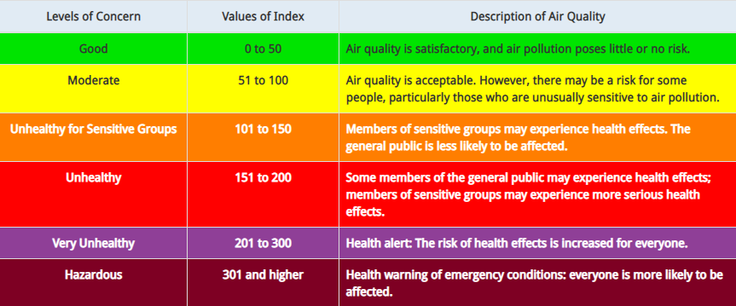
Introduction
Air pollution is defined as the presence of compounds in the atmosphere that are harmful to human beings and other living organisms
Has severe effects on human health - Respiratory issues, lungs and heart problems
Offering a holistic approach to tackle the issue of air pollution by building a device that can monitor air pollution, predict future levels of pollution and also suggest precautionary actions and methods to reduce air pollution

Slide 4
Motivation
Air pollution claims 7 million lives a year making it the most dangerous type of pollution
No present technology that is implemented on a large scale in urban areas
Lack of effective mobile apps
Lack of awareness
Demonstrate the possibility of a device to tackle to this problem which is:
  Cost effective
  Compact
  Easy to use
Help Bengaluru remain the Garden City of India for many years to come

Slide 5
Proposed System
We propose to build an IoT device using Arduino Uno and several sensors to detect pollutants such as Particulate Matter, Nitrogen Oxides, Sulphur Dioxide, Ozone, Carbon Monoxide, etc. Using hourly values of these sensors, we will calculate the sub indices of each pollutant and hence the AQI. AQI will be calculated per day.
Using the collected AQI data, and existing dataset from 2015 to 2020, and 2021-2022, we aim to build a Machine Learning model to forecast the AQI for the coming few days in Jayanagar-Basavanagudi region.
Why only this region? Because the AQI at any given time varies all over Bangalore. Hence, if we can model one area accurately, repeating the same for all other areas should be easy.
We aim to build a website showing daily forecasts of AQI, giving tips on reducing the AQI and precautionary measures to help people negate the effects of pollution, especially for people suffering from respiratory and cardiovascular complications.
We are also planning to implement an automated tweeting system to push tweets on Twitter everyday once the prediction has been made, to ensure easy access of information to all residents.

Slide 6
Objectives
Build an IoT system to monitor Air Quality:
  a) Monitor Concentrations of different air pollutants
  b) Measure AQI
Build a model to predict the Air Quality in the near future, using the output of the IoT system as input.
Build a web application to display the real time findings.
Provide analytics on the website, such as the maximum recommended limit and the current concentration.
Provide measures to improve Air Quality.
Provide precautionary measures.
Bring about air pollution awareness

Slide 7
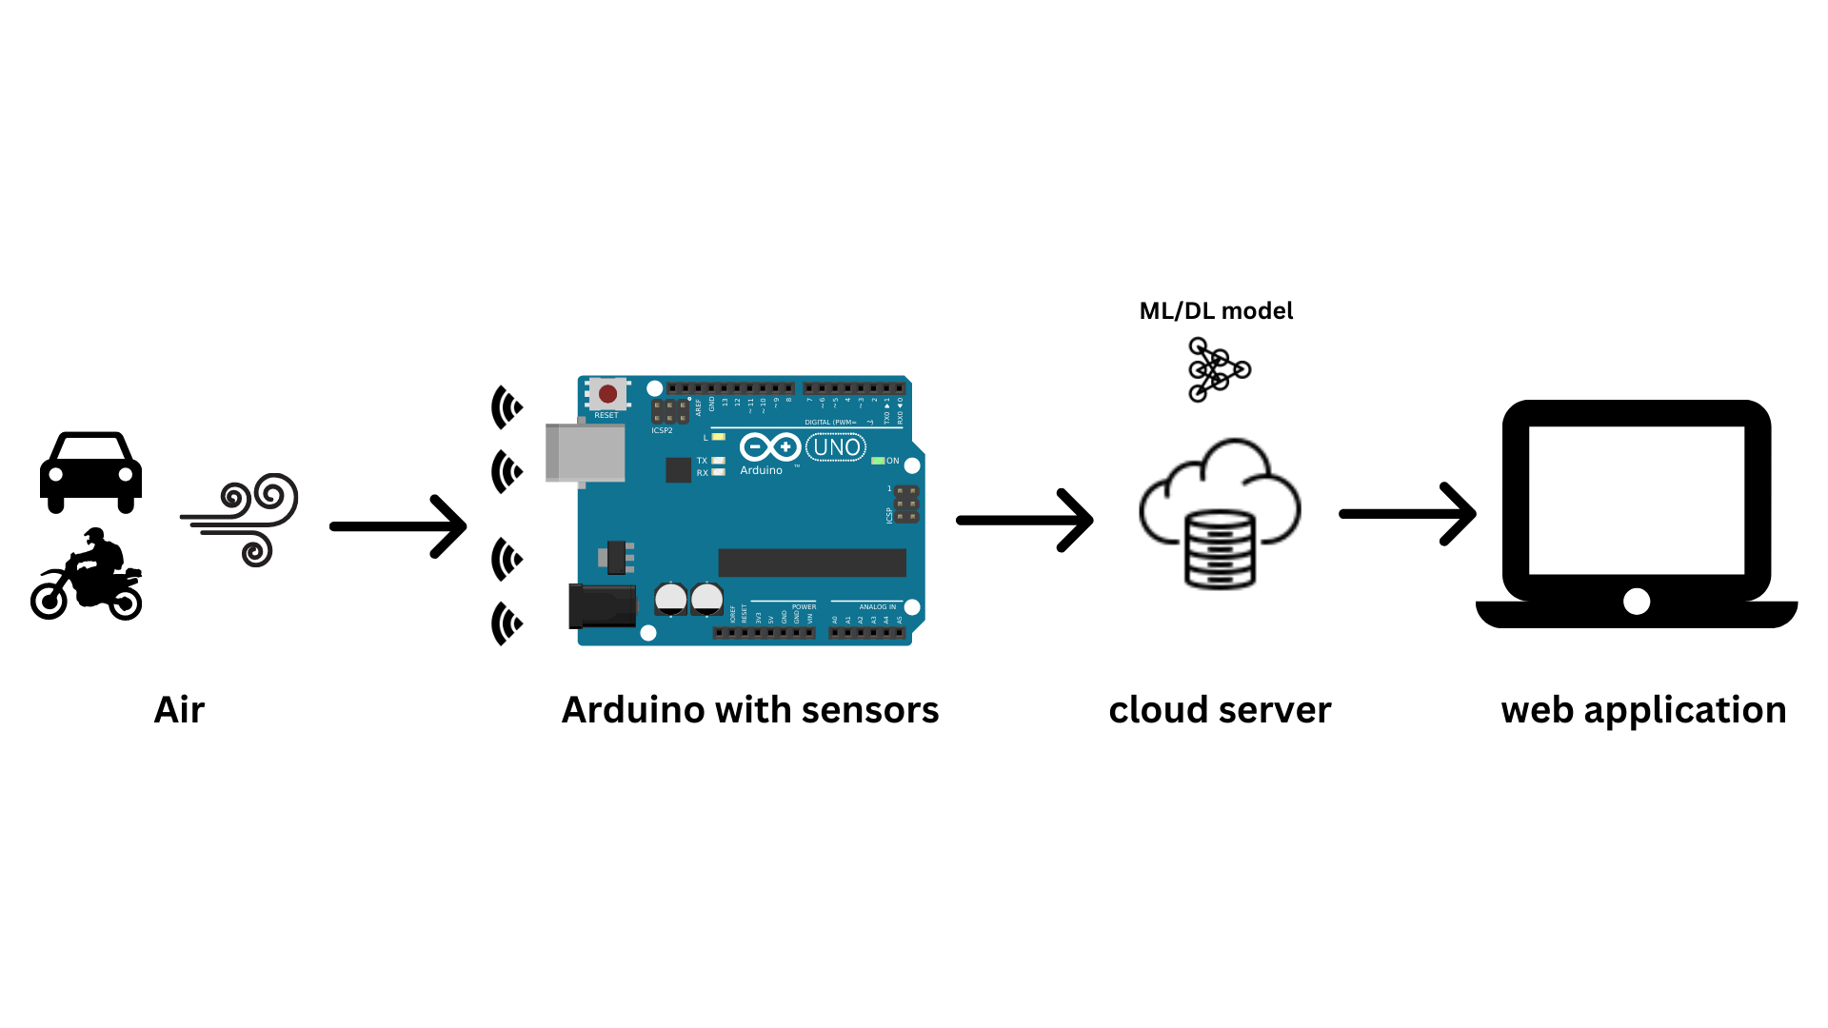
SYSTEM DESIGN
System Architecture

Slide 8
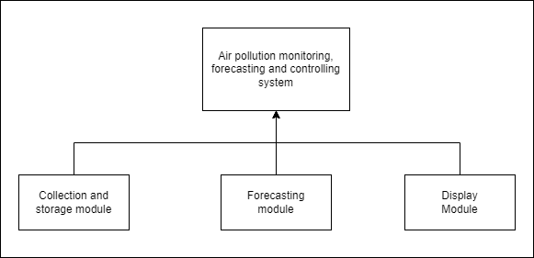
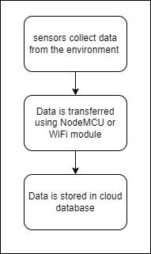
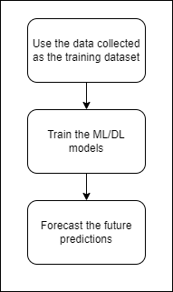
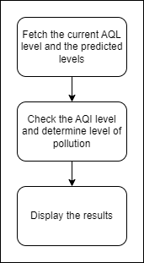
Module Design

Slide 9
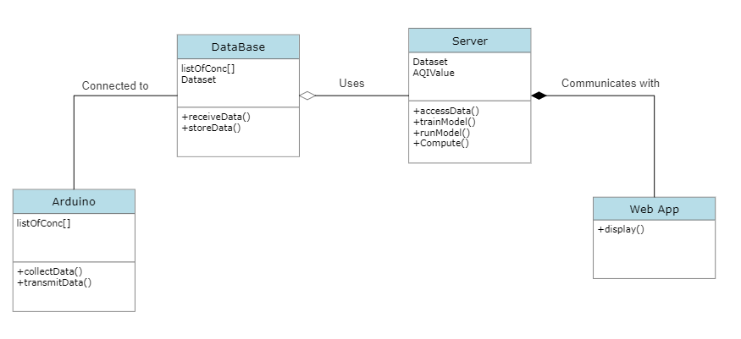
DETAILED DESIGN
Class Diagram

Slide 10
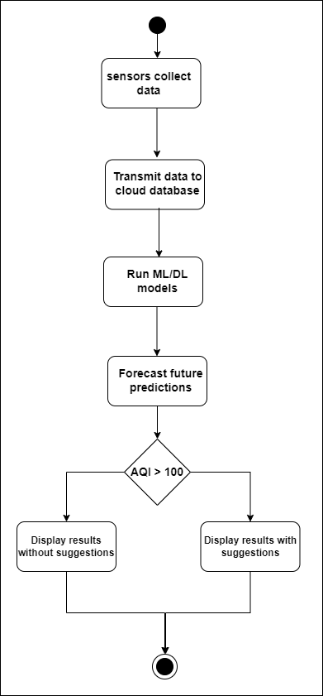
Activity Diagram

Slide 11
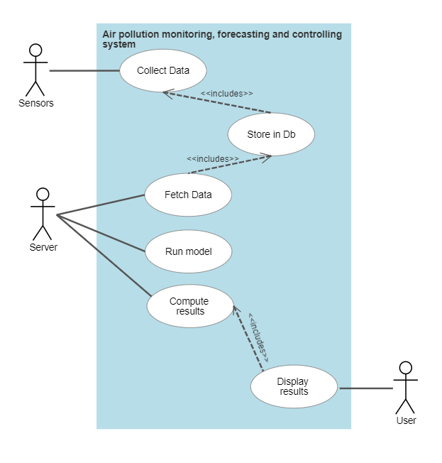
Use Case Diagram

Slide 12
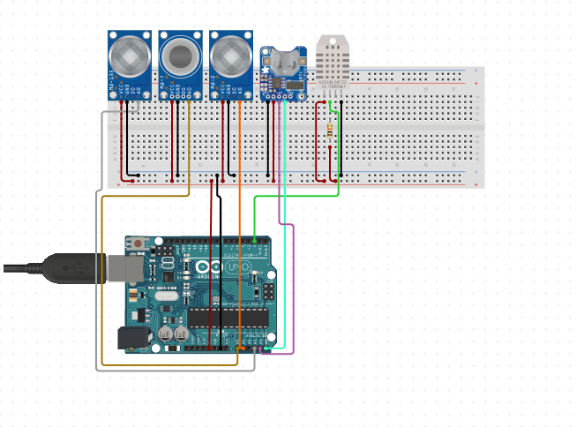
Implementation
Hardware Used:
Arduino UNO
DHT11 Sensor
MQ135 Air Quality Sensor
MQ131 Ozone Sensor
MQ7 CO Sensor
GP2Y1010AU0F
Dust Smoke Particle Sensor
Node MCU

Slide 13
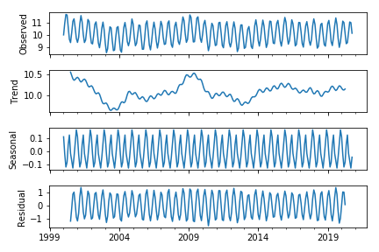
Implementation
Data Science Models explored:
AutoRegressive(AR) models are a subset of time series models, which can be used to predict future values based on previous observations. AR models use regression techniques and rely on autocorrelation in order to make accurate predictions.

Slide 14
Implementation
Data Science Models explored:
ARIMA:
Autoregression (AR): refers to a model that shows a changing variable that regresses on its own lagged, or prior, values.
Integrated (I): represents the differencing of raw observations to allow the time series to become stationary (i.e., data values are replaced by the difference between the data values and the previous values).
Moving average (MA): incorporates the dependency between an observation and a residual error from a moving average model applied to lagged observations.
SARIMA:
An extension to ARIMA that supports the direct modeling of the seasonal component of the series is called SARIMA.
12

Slide 15

13

